Slide 1
Commuter Aided Design CAD
Lecture 5

Slide 2
Modeling Concurrent Functionality in Verilog
Learning Outcomes—After completing this chapter, you will be able to:
Describe the various built-in operators within Verilog.
Design a Verilog model for a combinational logic circuit using continuous assignment and
logical operators.
Design a Verilog model for a combinational logic circuit using continuous assignment and
conditional operators.
Design a Verilog model for a combinational logic circuit using continuous assignment with
delay.

Slide 3



1- Verilog Operators
1.1 Assignment Operator Verilog uses the equal sign (=) to denote an assignment.
1.2 Continuous Assignment Verilog uses the keyword assign to denote a continuous signal assignment.
The left-hand side (LHS) of the assignment is the target signal and must be a net type.
Each individual assignment will be executed concurrently and synthesized as separate logic
circuits.

Slide 4
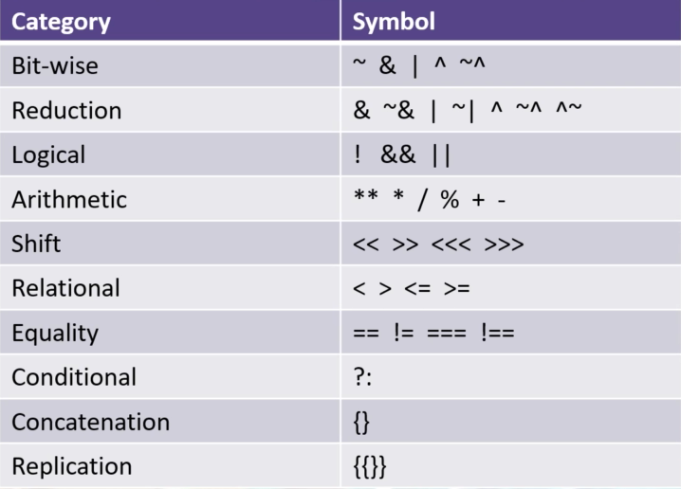
1- Verilog Operators
1.3 List of Verilog operators:

Slide 5
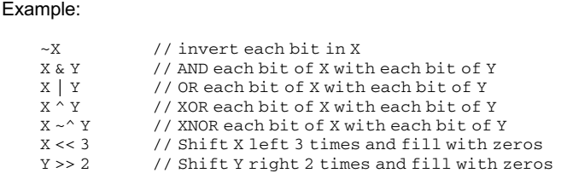
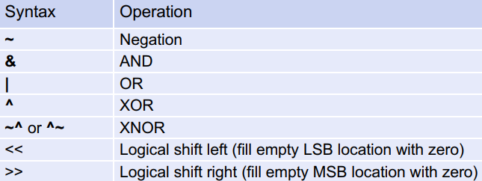
1- Verilog Operators
1.3 Bitwise Logical Operators

Slide 6
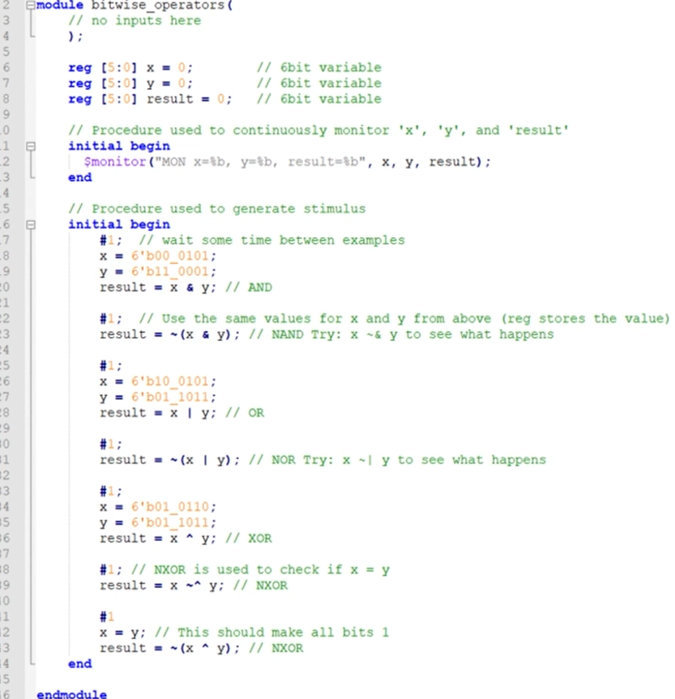
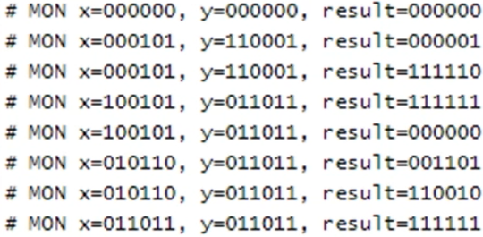
Hands-on time
Results:

Slide 7
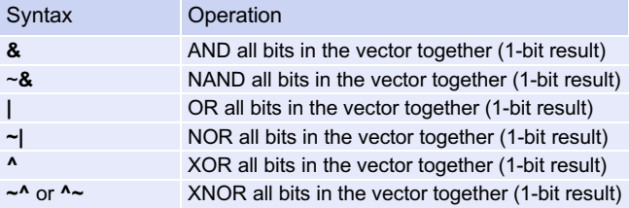
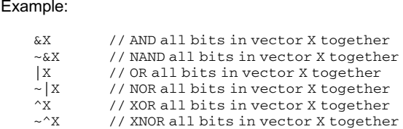
1- Verilog Operators
1.4 Reduction Logic Operators

Slide 8
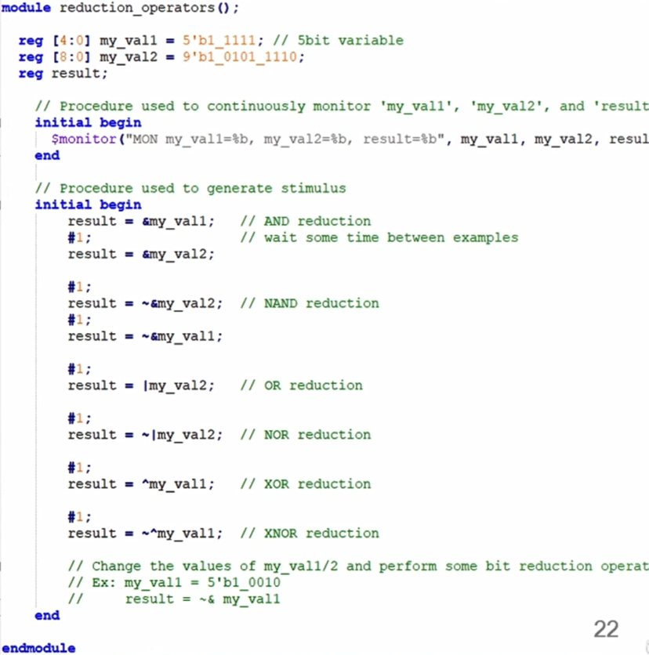
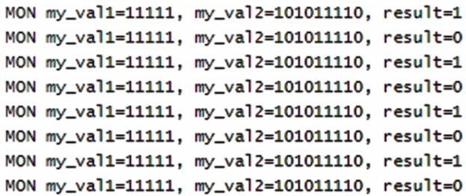
Hands-on time
Results:

Slide 9
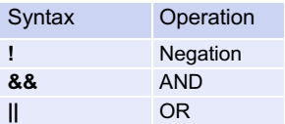
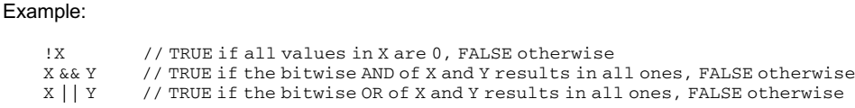
1- Verilog Operators
1.5 Boolean Logic Operators

Slide 10
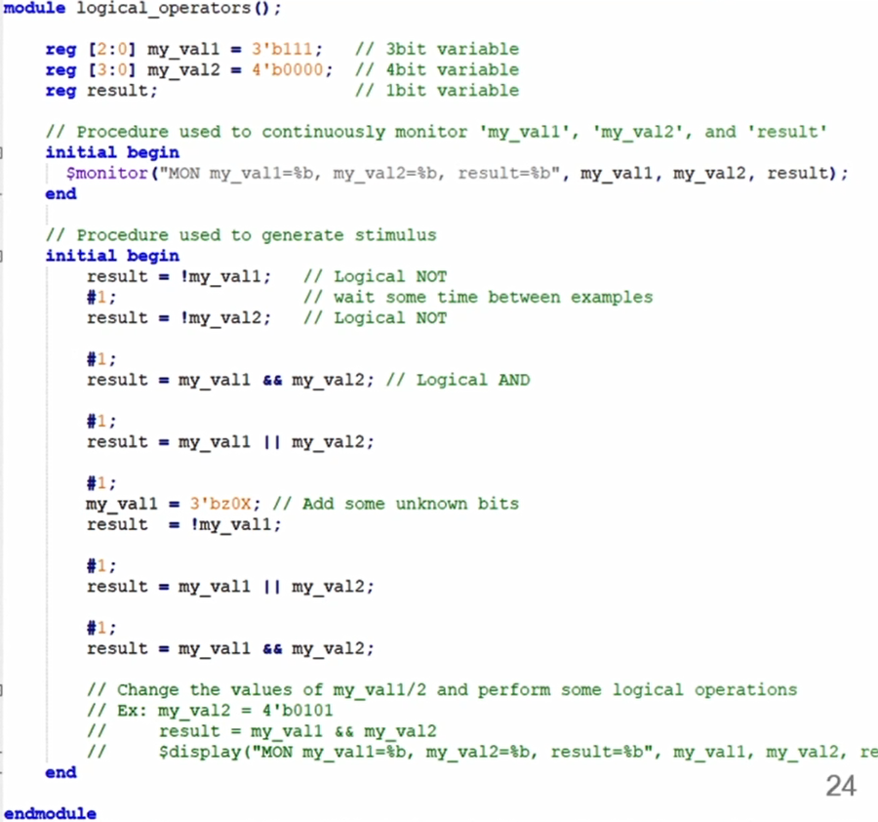
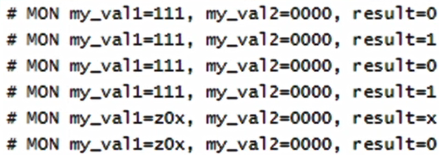
Hands-on time
Results:

Slide 11
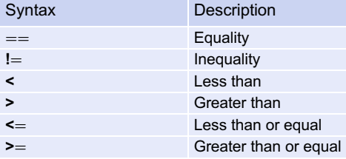
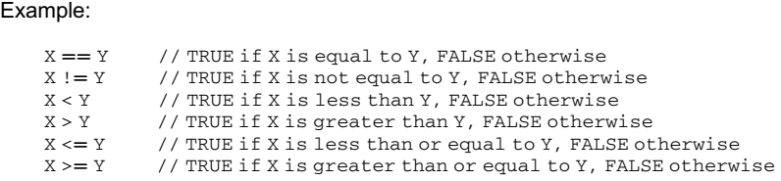
1- Verilog Operators
1.6 Relational Operators

Slide 12
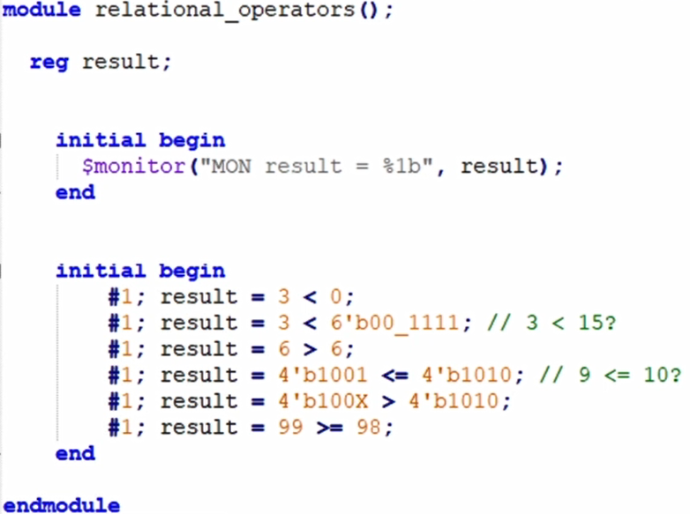
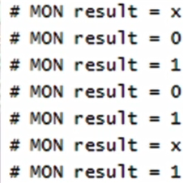
Hands-on time
Results:

Slide 13
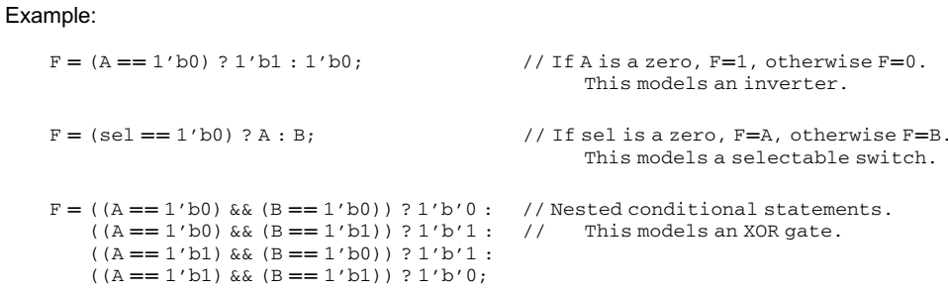
1- Verilog Operators
1.7 Conditional Operators The keyword for the conditional operator is ? with the following syntax:

Slide 14
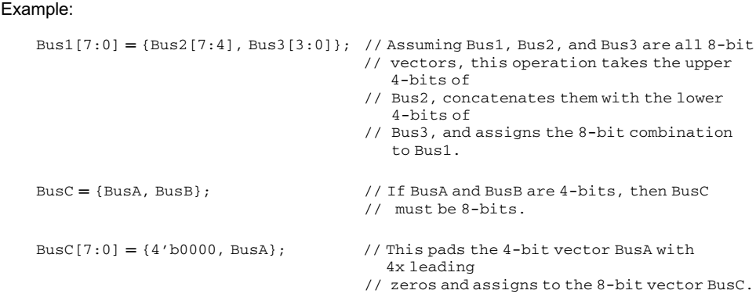
1- Verilog Operators
1.8 Concatenation Operator In Verilog, the curly brackets (i.e., {}) are used to concatenate multiple signals. The target of this operation must be the same size of the sum of the sizes of the input arguments.

Slide 15
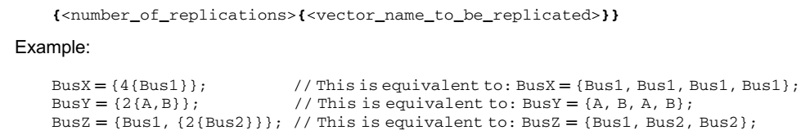
1- Verilog Operators
1.9 Replication Operator Verilog provides the ability to concatenate a vector with itself through the replication operator. This operator uses double curly brackets (i.e., {{}}) and an integer indicating the number of replications to be performed. The replication syntax is as follows:

Slide 16
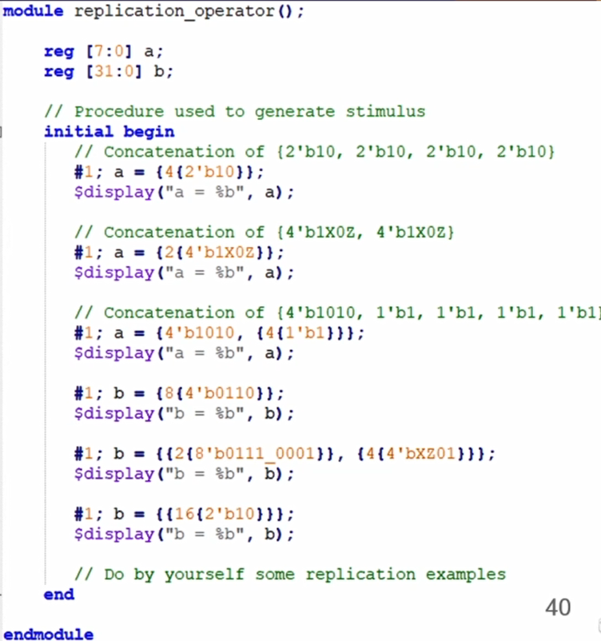
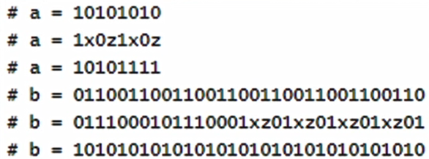
Hands-on time
Results:

Slide 17
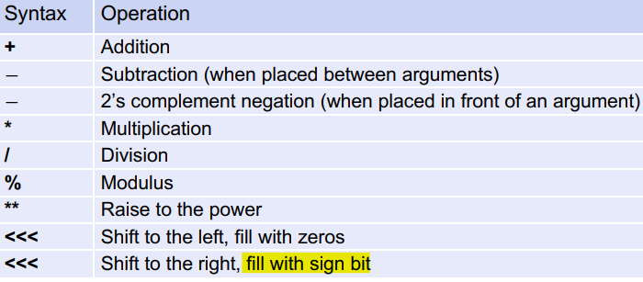
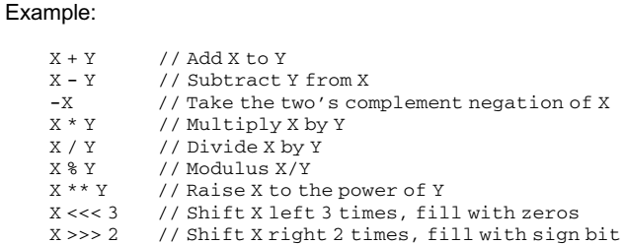
1- Verilog Operators
1.10 Numerical Operators

Slide 18
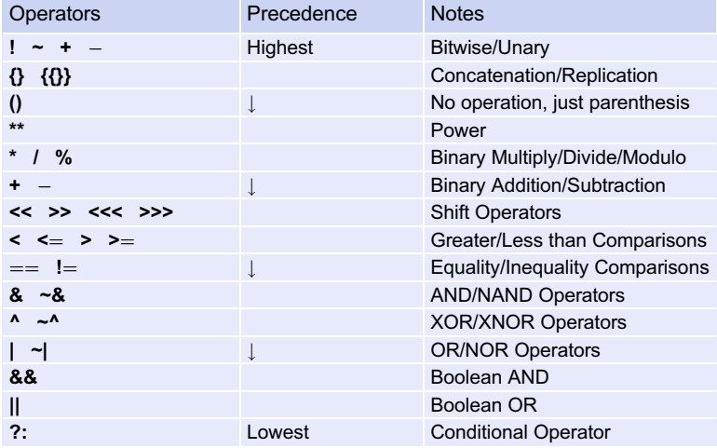
1- Verilog Operators
1.11 Operator Precedence

Slide 19
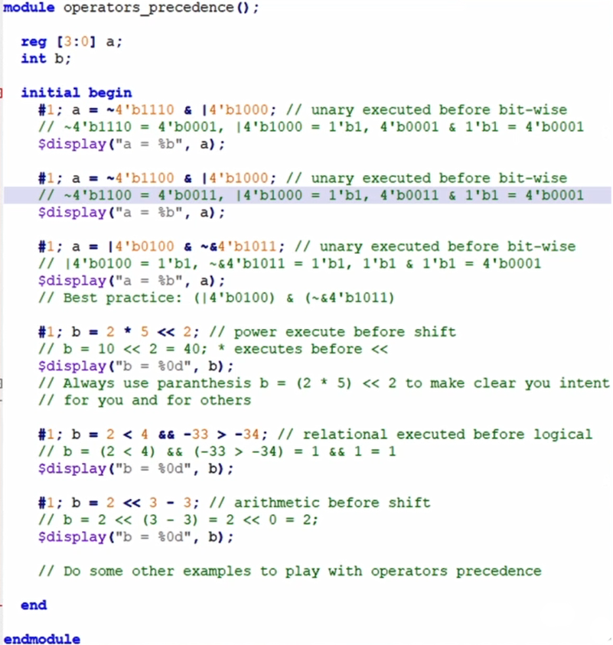
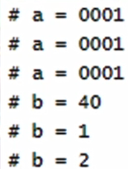
Hands-on time
Results:

